Slide 1
RURAL HEALTHCARE MONITORING

Slide 2
PROBLEM STATEMENT
Deficient Infrastructure
Not enough manpower
Equivocal quality of services
High out of pocket expenditure for Rural People

Slide 3
PROPOSED SOLUTION
Providing health band to Rural people to monitor their Vital Signs (IoT).
Providing portal to doctor and patient.
Ambulance service at the time of emergency.
Lab Test facility if required.

Slide 4
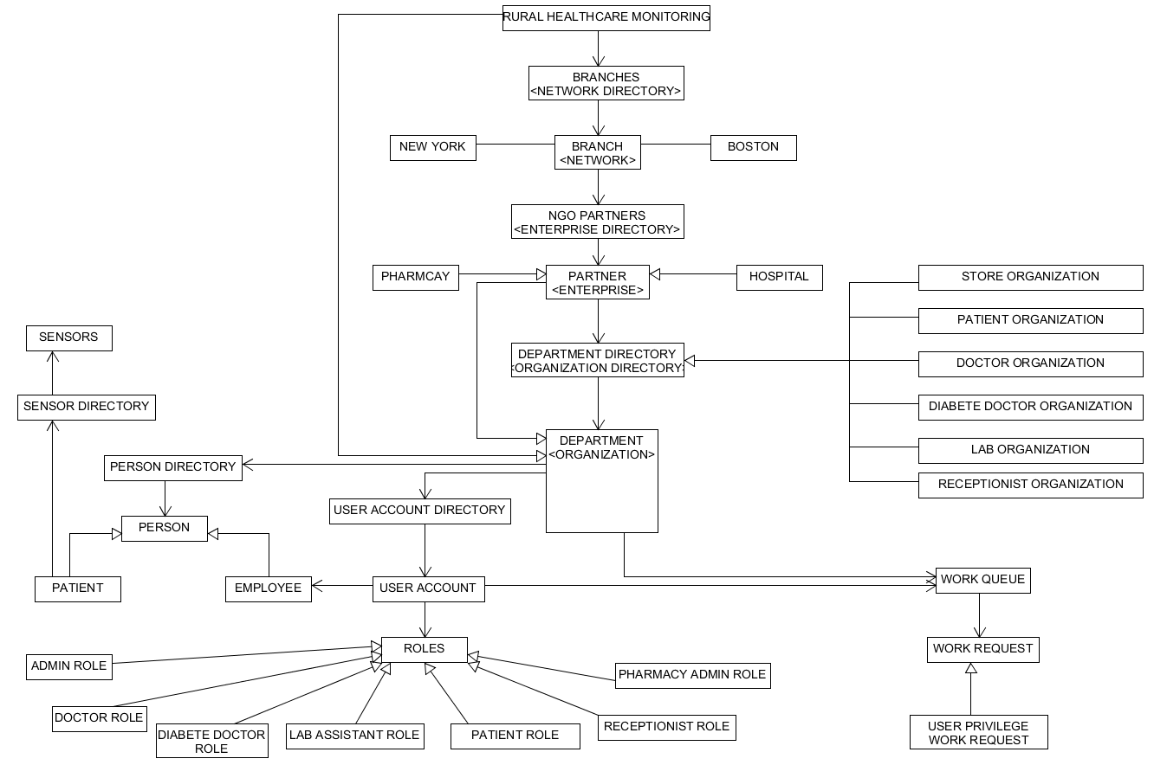

Slide 5
PATIENT ROLE
Patient can view the latest prescription
Book an appointment with doctor
Review his Medical History
Platform to Order Medicine
Will receive an notification in case of emergency

Slide 6
DOCTOR ROLE
Assign patient to themselves
Record his Vital Sign and check for other symptoms
Based on that will provide medicine and request an lab test if required
Receive an Alert when patient Vital Sign are low (Vital Sign are provided by Sensor)
Doctor can request an ambulance, if needed
Doctor can refer patient to Specialist Doctor

Slide 7
DIABETE DOCTOR ROLE
Diabetes doctor can track patient health using IoT
Book or reschedule an appointment with patient
Provide Diet Chart

Slide 8
KEY FEATURES
Vital Sign Monitoring using IOT
Medication ordered by Patient through the portal
Sending an Ambulance to patient on Button Click
Booking and rescheduling an Appointment with doctor
Prescribing medicine and lab test based on symptoms and vital sign history.

Slide 9
EXTRA FEATURES
Text message during Patient Sign Up.
Text and message to Patient when Ambulance is dispatched.
Call feature between Doctor and Patient.
Showing the line graph, bar graph and pie chart for patient Vital Sign History
Download the PDF format of patient expense report.
Email confirmation to patient on booking an appointment.

Slide 10
THANK YOU

